Slide 1
The liver

Slide 2
Anatomy of the liver
The liver is the largest organ in the body weighing about 1.4kg (3lb)
The inferiorly to the diaphragm and occupies most of the right hypochondriac and epigastric regions
The liver has two principle lobes, the right lobe and the left lobe that are separated by a connective tissue septum called falciform ligament
On the inferior surface two more lobes can be seen, these are caudate and quadrate lobe

Slide 3
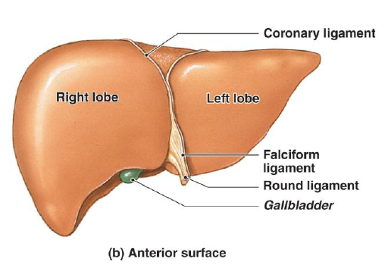
The liver

Slide 4
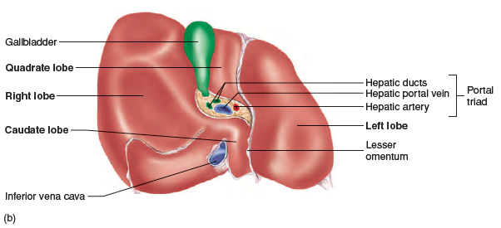
The liver

Slide 5
On the inferior surface of the left lobe of the liver, two more lobes can be seen
The caudate
The quadrate lobe

Slide 6
Supporting structures of the liver
The falciform ligament – extend from the undersurface of the diaphragm and suspend the liver to the abdominal cavity
Ligamentum teres – remnant of ambilical veins and suspend the liver to the abdominal umbilicus
The right and left coronary ligament – suspend the liver to the diaphragm
Inferior and superior vena cava also suspend the liver in position
Pressure from abdominal organs also helps suspend the liver in position

Slide 7
Liver histology
Histocytes
This is the main functional cells of he liver that include metabolic, secretary, and endocrine functions
Hepatocytes form a complex three-dimentional arrangements called hepatic laminae
Hepatic laminae are plates of cells that line hepatic sinusoids

Slide 8
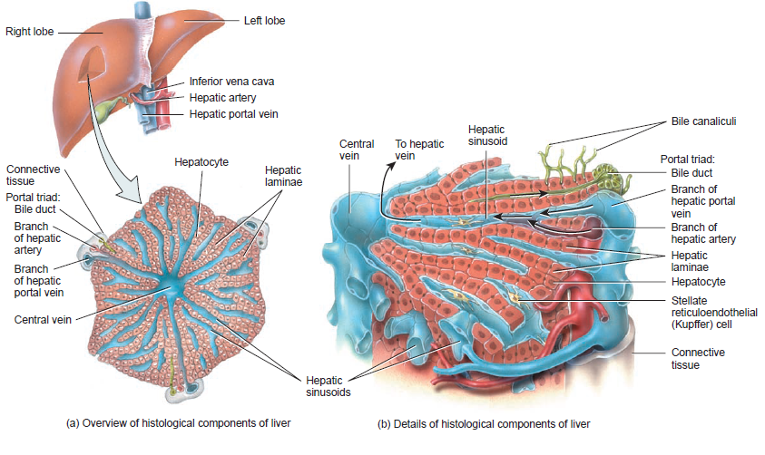
Component of liver cell

Slide 9
Liver histology
Bile canaliculi
These are small ducts between hepatocytes that collect bile produced by hepatocytes
Bile flows from bile canaliculi to bile ductules and to bile ducts
Bile ducts unite to form right and left hepatic ducts leading to common hepatic ducts
The common hepatic ducts joins cystic ducts to form common bile ducts

Slide 10
Liver histology
Hepatic sinusoids
These are blood capillaries that are highly permeable
It receives blood from hepatic artery and nutrient-rich deoxygenated blood from hepatic portal vein
Hepatic sinusoids converge into a central vein that delivers blood to hepatic vein and then to inferior venacava
Within hepatic sinusoids, there are fixed phagocytes call stellate reticuloendothilial (kupffer) cells
The bile duct, hepatic artery and hepatic vein are referred to as portal triads

Slide 11
Functions of kupffer cells
Remove pathogens, cell debris, damaged erythrocytes
Remove and store iron
Remove and store lipids
Remove and store heavy metals

Slide 12
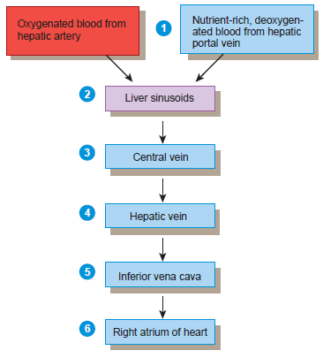
Blood flow through the liver

Slide 13
Functions of the liver
Carbohydrate metabolism
Convert excess glucose into a storage form-glycogen
Break stored glucose to restored glucose level in blood
Convert lactic acid and amino acid into glucose
Convert fructose and galactose into glucose
Lipids metabolism
Synthesize fatty acids to generate ATP
Synthesize lipoprotein that transport fatty acid, triglycerides
Synthesize cholesterol that is used for making bile

Slide 14
Functions of liver
Protein metabolism
Deamination of amino acid to generate ATP and glucose or fat
Removal of ammonia
Synthesis of plasma protein
Processing drugs and hormones
By detoxifications substances like alcohol and drugs
Alter steroid/thyroids hormone for excretion
Excretion of bilirubin from the breakdown of worn out red blood cells

Slide 15
Functions of the liver
Synthesis of bile salts which is necessary for emulsification of fat in the small intestine
Storage of carbohydrate ass glycogen and vitamins – A.D.E.K, Vit B₁₂ and minerals(copper and iron)
Phagocytosis by kupffer cells of old red blood cells and bacteria
Activation of vitamin D

Slide 16
Carbohydrate metabolism
Describe the fate, metabolism, and functions of carbohydrates.

Slide 17
The fate of glucose
The fructose and galactose absorbed are converted by hepatocytes to glucose
Glucose is the main source energy in the body and is used in the following way
ATP production- glucose is oxidized into ATP that provide energy for body processes
Amino acid synthesis – cells use glucose to form amino acid
Glycogen synthesis – forms polysaccharides and stored
Triglyceride synthesis – hepatocytes transform glucose to glycerol and fatty acids that can be ussed for lipogenesis i.e. synthesis of triglycerides and stored in adipose tissue

Slide 18
Glucose movement into the cells
For glucose to be used by the body, it must cross the plasma membrane and enter the cytosol
Glucose cross the plasma membrane by secondary active transport or Na+ -glucose symporters
High level of insulin in the body increases intake of glucose by the cells

Slide 19
Glucose catabolism
The oxidation of glucose to produce ATP is called cellular respiration that takes place in four steps
Glycolysis
Glucose molecules is oxidized to peruvic acid in the absent of oxygen (anaerobic cellular respiration) resulting in two molecules of ATP and two energy containing NAD + H⁺
Formation of acetlycoenzymes A
This a transition step for peruvic acid into a kreb cycle
Kreb cycle reactions
Acetylcoenzyme is oxidized producing CO2, ATP and high energy compound
Electron transport chain reactions
High energy compound NAD and FADH is transferred through many series of electron carriers. This step ans and kreb cycles require oxygen (aerobic cellular respiration)

Slide 20
Protein metabolism
Protein are absorbed into the body and oxidized to produce ATP or use to synthesize new proteins for body growth and repairs
Fate of proteins
After digestions, amino acids are reassembles into proteins and used as follows
making of enzymes
Making of antibodies
Making clotting chemicals
Making hormones
Development of structural component of the body

Slide 21
Protein catabolism
Protein catabolism is stimulated by cortisol, an adrenal hormone
Worn-out cells are broken down into amino acids, peptides are resynthesized as part of the recycling process
Hepatocytes convert some amino acids into fatty acids, ketone bodies or glucose
Some amino acid generates ATP through the kreb cycles where amino acid is first deaminated. NH₂ is removed and converted by the liver into NH₃ and changed to urea for excretion
The remaining of amino acid is converted and enter the kreb cycle

Slide 22
Protein anabolism
This the formation of peptide bond to produce new proteins
It take place in the ribosome directed by the cell DNA and RNA
The hormone such as T3 & T4, insulin-growth factor, estrogen and testosterone stimulate protein synthesis
Protein sysnthesis is important for body repairs
Human body contain 20 amino acids. 10 are essential amino acids because the body is unable to synthesize them and must be provided in the diet
Non-essential amino acid can be synthesized by the body

Slide 23
Lipids metabolism
Most lipids (trigycerides) are hydrophobic i.e. do not dissolve in water
To dissolved in water, lipids must combine with protein to form lipoprotein ( triglyceride is surrounded is protein, phospholipid and cholesterol)
The protein in the outer shell is called apoprotein
Chylomicron helps to transport lipids to the adipose tissues for storage

Slide 24
Types of lipoprotein
Very low-density lipoprotein
Contain high level of triglycerides and moderate concentration of cholesterol and phospholipids
Low-density lipoprotein (LDL)
This lipoproteins contain only cholesterol and phospholipids
LDL is called a bad cholesterol because it carries cholesterol and phospholipids from the liver to different areas of the body. It causes atherosclerosis (blockage and hardening of arteries
High density lipoprotein
Contain high density if protein low concentration of cholesterol and phospholipids
HDL is good cholesterol because it caries cholesterol and phospholipids from tissues and organs back to the liver for degradation. It a good indicator a healthy heart because it reduces cholesterol

Slide 25
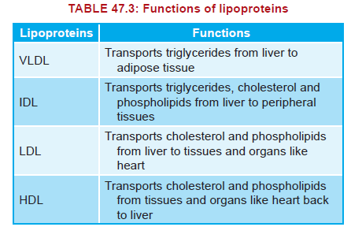

Slide 26
Fate lipids
Lipid is oxidized to release ATP
Lipid is stored in adipose tissues for future use
Lipids can also be used as structural molecules
It can also be used for synthesizing other essential substances e.g. lipoprotein,
Two fatty acid not synthesized in the body is linoleic acid and linolenic acid

Slide 27
Lipid catabolism
The process of lipid catabolism is called lipolysis
The triglyceride is broken up into glyerol and fatty acid molecule
Lipolysis is catalyzed by the enzyme lipase
Epinephrine and and norepinephrine catalyzed the break enhances the breakdown of norepinephrine into fatty acid and glycerol
Glycerol is catalyzed into glyeraldehyde 3-phosphate and converted to glucose
Fatty acid is catalyzed to produce ATP in the body

Slide 28
Lipid anabolism
This is the process of build up of lipids from glucose or amino acid
The process is called lipogenesis
Lipogenesis occurs when more calories are eaten than needed by the body
amino acids→ acetylCoA→ fatty acids→ triglycerides.
Glucose → glyceraldehyde→ 3-phosphate glycerol →
glucose → glyceraldehyde3-phosphate → acetyl CoA → fatty acids.

